Slide 1

Finding and using images on JSTOR
A deck to reuse for training and presentations

Slide 2
Notes:
More about the history of JSTOR and ITHAKA: about.jstor.org/mission-history/

Slide 3
Planning your presentation or workshop
For the presenter
Notes:
This deck is yours to use in any setting in whole or in part. As JSTOR evolves and new features are added, we update this slide deck for you. Please check back to this URL for updates periodically and note the date last updated on this slide.
For the latest information, check our Release Notes for JSTOR for updates.

Slide 4
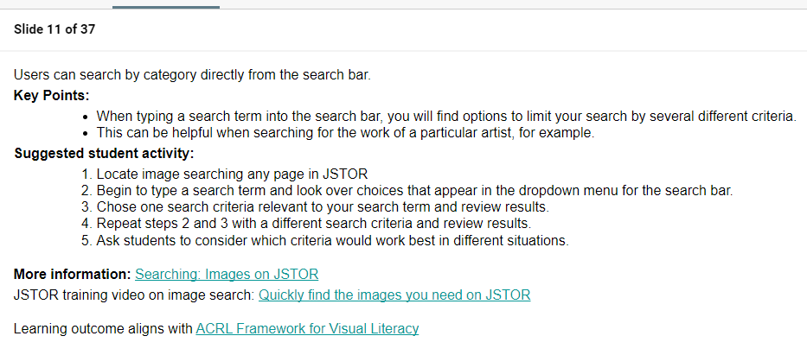
How to use this deck:
Copy to adapt to your training needs
Check back for any updates JSTOR Education makes to this deck
Choose individual slides or sections by audience and/or choose slides based on your time constraints
Read speaker's notes of each slide for:
  key points
  suggested student activities
  more information
Notes:
Consider this deck to be a living document.
Make a copy
Save this link and check the it for updated slides when revising any presentation that includes JSTOR
Give us feedback at support@jstor.org
For the latest information, check our Release Notes for JSTOR for updates.

Slide 5
Suggested student activities
Activity | slide
Searching | 11-12
Downloading | 14
Advanced search | 15
Browsing | 18
Creating a personal account (logging in) | 21
Saving to your Workspace | 27
Organizing and Exporting (downloading) | 30
Sharing a folder from your Workspace | 32
Citing | 34
Notes:
The slides where you will find specific Suggested student activities to engage with are notice here.
Key points:
All the learning activities are in the speaker’s notes.
We have aligned the learning outcomes expected from these activities with the ACRL Framework for Visual Literacy.

Slide 6
Table of contents
Finding and using images on JSTOR | slide
Searching | 9-14
Advanced search | 15
Browsing | 16-18
Your Workspace | 19
Creating an account/Logging in | 20-22
Saving | 23-27
Organizing | 28-31
Sharing | 32
Citing | 33-35
Notes:
The speaker’s note include key points, links to more information, and the steps for each student activity.
Choose slides based on your training goals.

Slide 7
Finding and using images on JSTOR

Slide 8
Notes:
More about the history of JSTOR and ITHAKA: about.jstor.org/mission-history/

Slide 9
Searching for images
Notes:
In this section, we will cover getting started with image search.

Slide 10

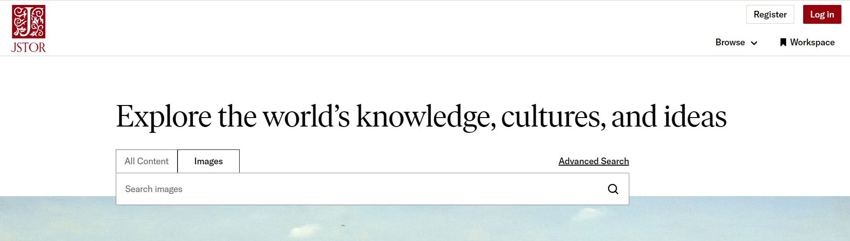
Searching > techniques
Two places you can begin your image search on JSTOR
Notes:
Search and Advanced Search can be performed on JSTOR
Key Points:
The image tab from the search bar allows your to quickly get started.
The image tab on the advanced search page provides more guidance in constructing a search.
More information: Images on JSTOR: Getting Started
Images on JSTOR YouTube playlist

Slide 11
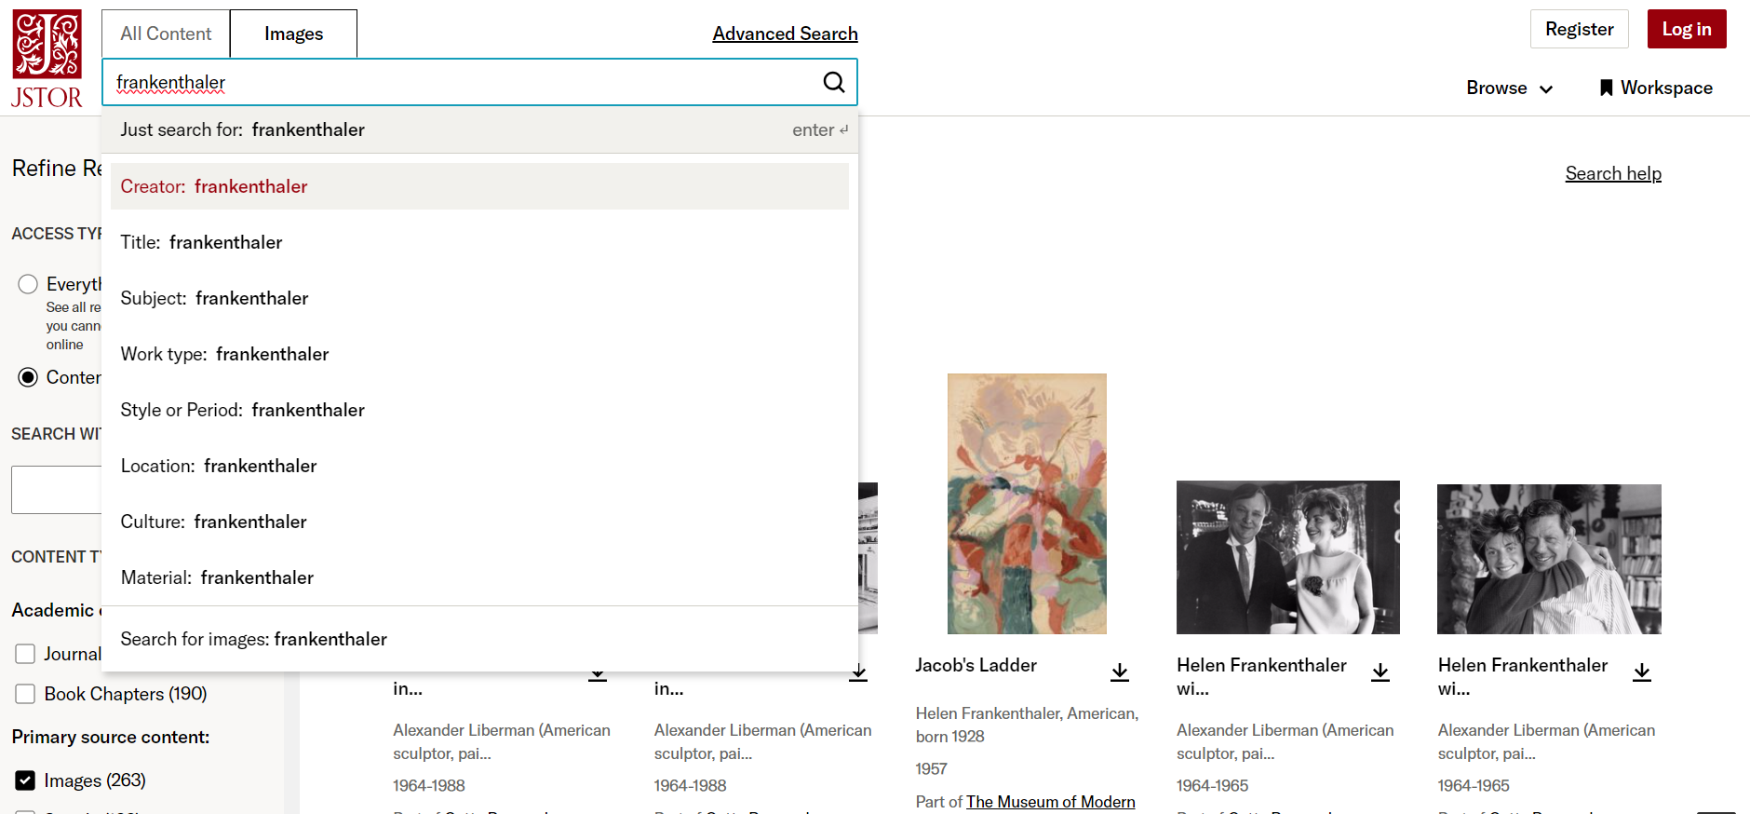
Searching > by category
Notes:
Users can search by category directly from the search bar.
Key Points:
When typing a search term into the search bar, you will find options to limit your search by several different criteria.
This can be helpful when searching for the work of a particular artist, for example.
Suggested student activity:
Locate image search on any page in JSTOR
Begin to type a search term and look over choices that appear in the dropdown menu for the search bar.
Chose one search criteria relevant to your search term and review results.
Repeat steps 2 and 3 with a different search criteria and review results.
Ask students to consider which criteria would work best in different situations.
More information: Searching: Images on JSTOR
JSTOR training video on image search: Quickly find the images you need on JSTOR
Learning outcome aligns with ACRL Framework for Visual Literacy

Slide 12
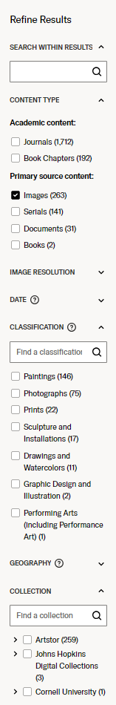
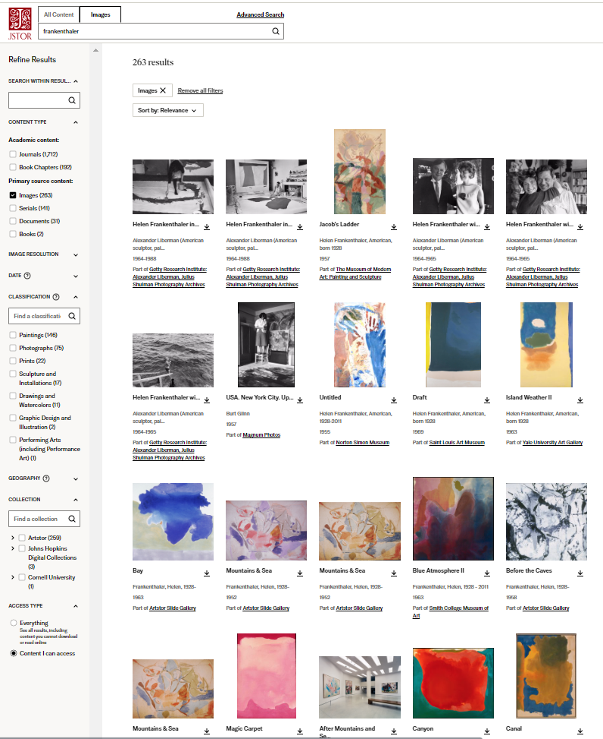
Searching > refining results
Use the sidebar to narrow results by:
date
image resolution
classification
country
collection
And search within results using additional keywords
Notes:
The Refine result sidebar is a tool that can help users gradually narrow the scope of a search depending on results.
Key Points:
Search within results allows users to add more keywords to their search.
Content type can be explored - finding articles or book chapters on the topic, for example.
Image resolution can be used to find the most detailed images.
Date ranges can be changed.
Classification refer to the type of object being searched (painting or sculpture, for example).
Collection refers to the organization that is sharing the image. Artstor is a collection that contains several collections from various sources world wide.
Only the classifications, collections, or geographical locations relevant to the search terms appear.
The scope of a search can be narrowed by more than one criteria.
Boxes can be checked or unchecked as the user reviews results.
Suggested student activity. Ask students to:
conduct a search and then narrow their results using the choices in the refine results sidebar.
choose more than one criteria and change criteria to observe different results.
add an addition search term in the ‘Search within results’ bar and consider how search results change with these actions.
More information: Searching: Images on JSTOR
YouTube: Refining image search results on JSTOR
Learning outcome aligns with ACRL Framework for Visual Literacy

Slide 13
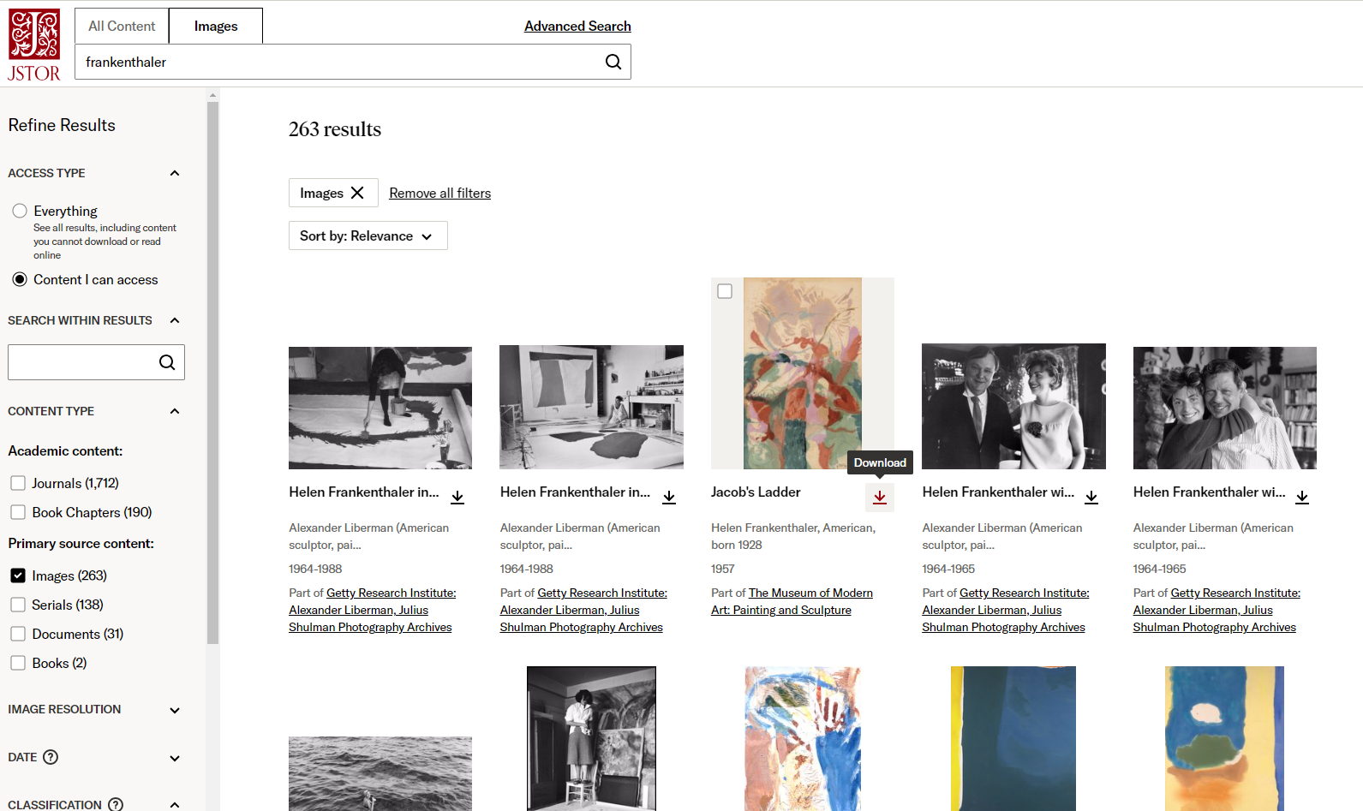
Searching > downloading from search results
Notes:
Key Point: It is possible to download a single image from the search results page.

Slide 14

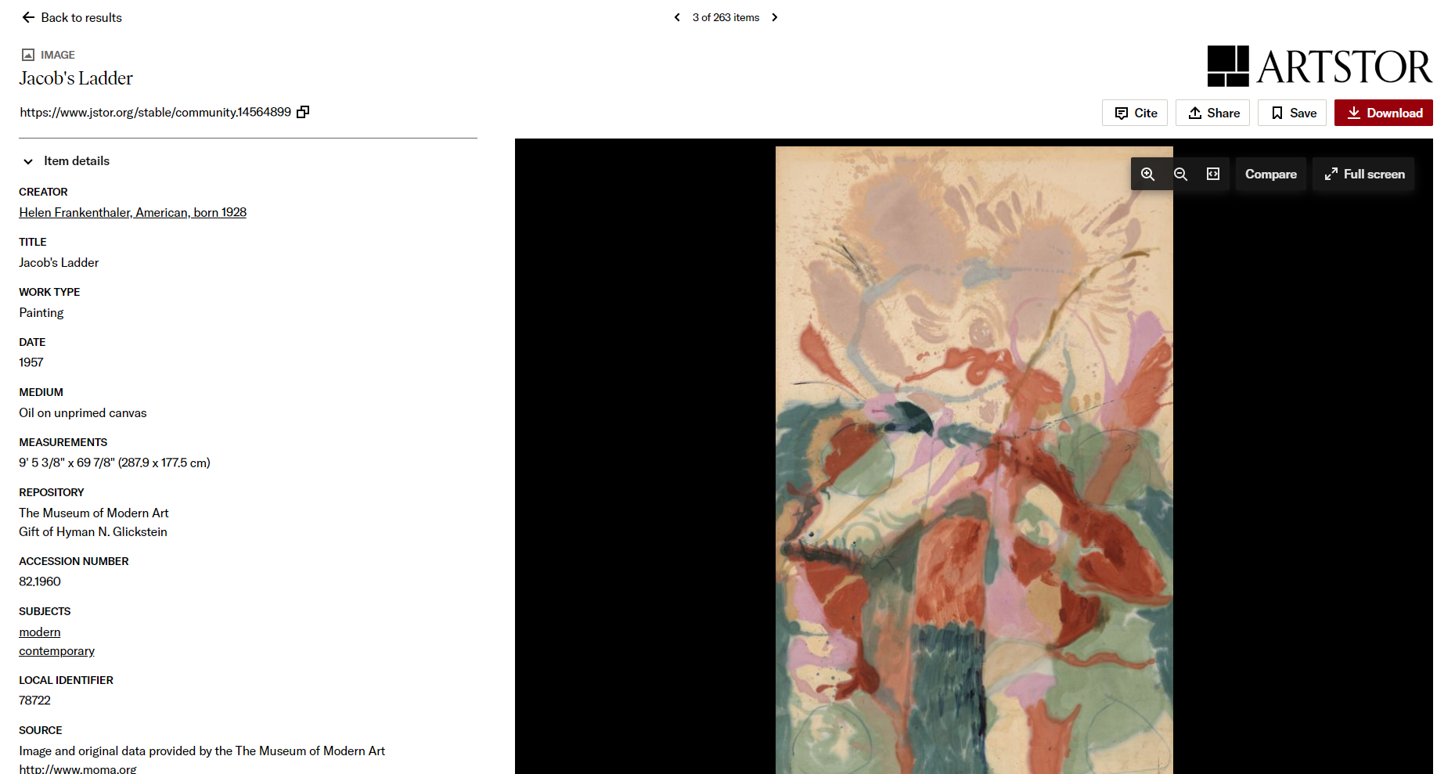
Searching > downloading from the item page
click on the Download button on the item page
Notes:
Key Point: You can also download from the image item page.
Suggested student activity:
Conduct an image search on JSTOR.
Choose an item from the search result and download it.
Click on another item and download that from the item page.
More information: Images on JSTOR: Getting Started- Downloading images
Learning outcome aligns with ACRL Framework for Visual Literacy

Slide 15
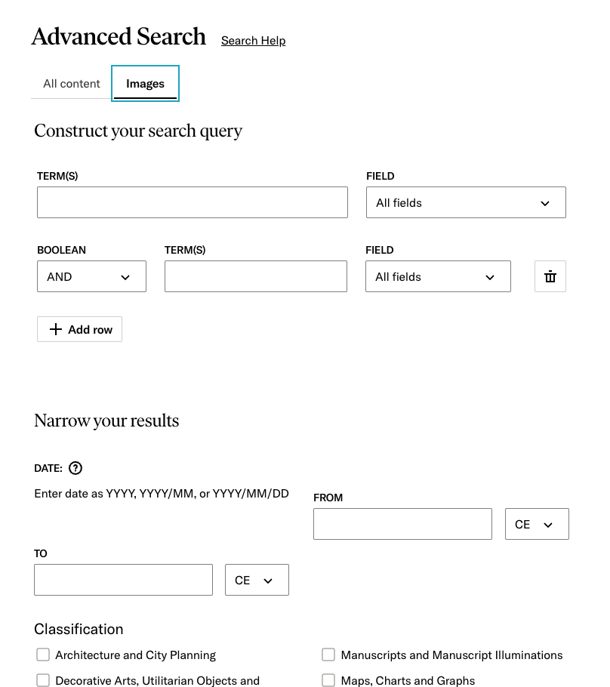
Searching > advanced search
Choose the image tab on the advanced search page
Notes:
Key Point: The advanced search form guides you through constructing a highly structured search.
Suggested student activity.
Ask students to:
Locate advanced image search (see slide 10)
Construct a search using the operator “AND”
Students may want to experiment with
other operators and fields
narrowing results by classification, collection or date
Students may want to experiment further with fields, oprotators, and other ways to narrow their image results
Students can execute a search by either scrolling down to the bottom of the page and choosing the “Submit” button or just hitting return on their keyboard.
More information: Images on JSTOR: Getting Started
Learning outcome aligns with ACRL Framework for Visual Literacy

Slide 16
Browsing
Notes:
Browsing is a great way to discover new images, especially if you don’t know exactly what you are looking for.

Slide 17

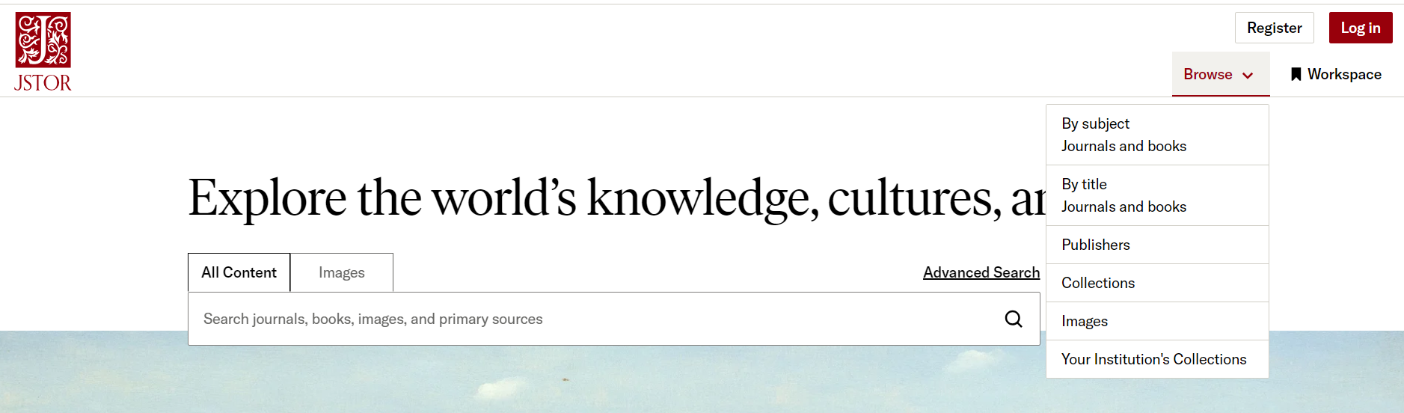
Browsing > images
Choose images from the browse dropdown menu
Notes:
Key Point: A dedicated image browse/search page can be found by choosing ‘Images” from either the Browse dropdown menu.
More information: Images on JSTOR: Getting Started
Images on JSTOR YouTube playlist

Slide 18
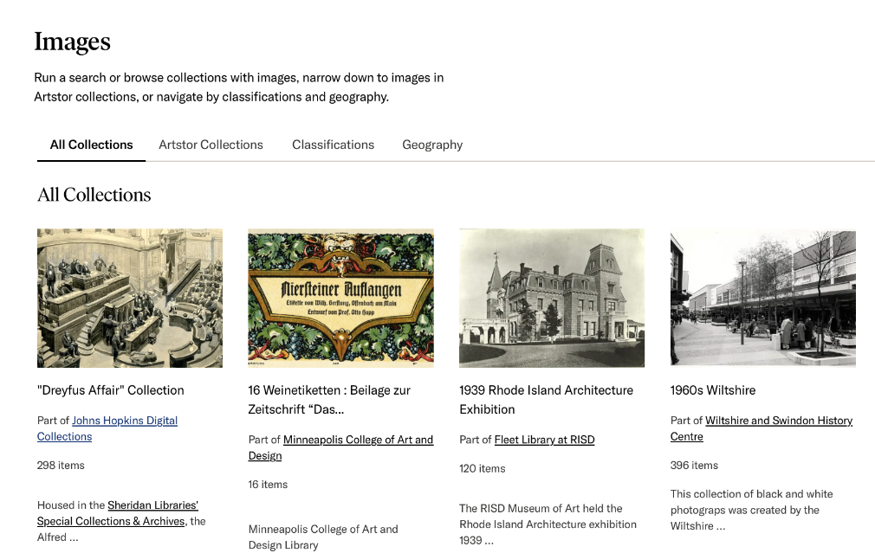
Browse > collections
Image browse page provides several options for exploration
All Collections from libraries around the world
Artstor Collections curated from museums and libraries
Classification choose from sixteen categories
Geography choose a region or country
Notes:
Key Points:
Each tab can be explored with or without a keyword search.
All collections include contributors who share content through JSTOR.
Artstor collections is content shared through Artstor that is curated from museums and libraries.
classifications allow the user to narrow to a category of image like architecture or painting.
browse by geography can provide location as a starting point.
Each of these categories can be further refined in the Refine Results sidebar once you have executed the initial search.
Suggested student activity:
Navigate to Browse>Images
Choose a search term
Execute that search under the “All Collections” tab
Scroll down the Refine results sidebar and explore the various collections available to you and try filtering by other criteria.
Navigate to Browse>Images again and execute the same search under the “Artstor Collections” tab.
Scroll down the Refine results sidebar, and open the carrot (>) for the Artstor collection and explore
to explore the subcollections of Artstor
Navigate to Browse>Images again and choose a classification and then use the refine results sidebar to explore the results further by date range, key word, and geography.
Navigate to Browse>Images one last time and begin your exploration with Geography
Determine which tab works best for your research goals.
More information: Images on JSTOR: Getting Started
Images on JSTOR YouTube playlist
Learning outcome aligns with ACRL Framework for Visual Literacy

Slide 19
Your Workspace
> saving what you find
Notes:
Now that you can search and browse, let’s talk about saving content.
Key points:
The save button saves any item you find on JSTOR to your Workspace
If you don’t have a personal account yet, when you save an item, you will be prompted to create that account
More information: Introduction to Workspace – JSTOR Support
Finding and saving images on JSTOR - Artstor on JSTOR: Working with images - LibGuides at JSTOR

Slide 20

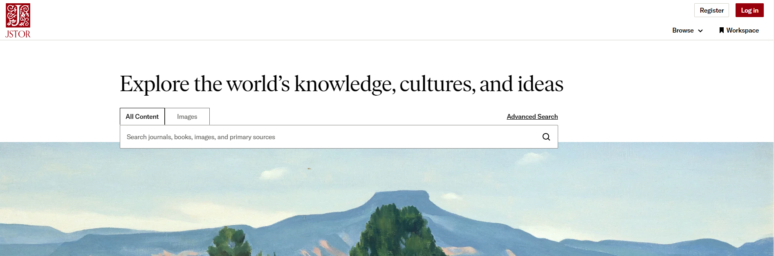
Workspace > your personal account
Use Workspace for saving and organizing what you find on JSTOR.
You can find the Workspace button on every page
Notes:
Key Points:
Everyone using JSTOR is able to create a free personal account.
Workspace can be accessed from any page in JSTOR
You must create a personal account to use Workspace.
The personal account allows anyone access to their Workspace where they can
save items to your Workspace
download more than one item at a time
share folders of content with others.
More information: Introduction to Workspace – JSTOR Support

Slide 21
Access JSTOR from anywhere using your personal account
Workspace > the personal account
When you’re logged in with your personal account, you get:
  365-day remote access
  Pairing of your account with your institution
  Single Sign-on (if enabled at your institution)
  Access from any computer, phone, or other device
Notes:
Because the most frustrating thing is hitting a paywall for something you actually have access to through your institution, your personal account authenticates your access through their institution.
Key Points:
Besides giving you access to your own Workspace, the a free personal account creates easy access to JSTOR.
The personal account provides seamless access to JSTOR from anywhere for 365 days.
That clock resets each time a user logs in from on campus or through their institution’s portal during that period.
This makes it easy to get to JSTOR, even if you access JSTOR from discovery on Google Scholar or were given a link by a faculty member.
This will work even on your phone, or other mobile device.
Suggested student activity:
On JSTOR, Click on Workspace
If you have not yet created a personal account, click on Register
If you have a personal account, log in
More information: Introduction to Workspace – JSTOR Support
Finding and saving images on JSTOR - Artstor on JSTOR: Working with images - LibGuides at JSTOR
Learning outcome aligns with ACRL Framework for Visual Literacy

Slide 22
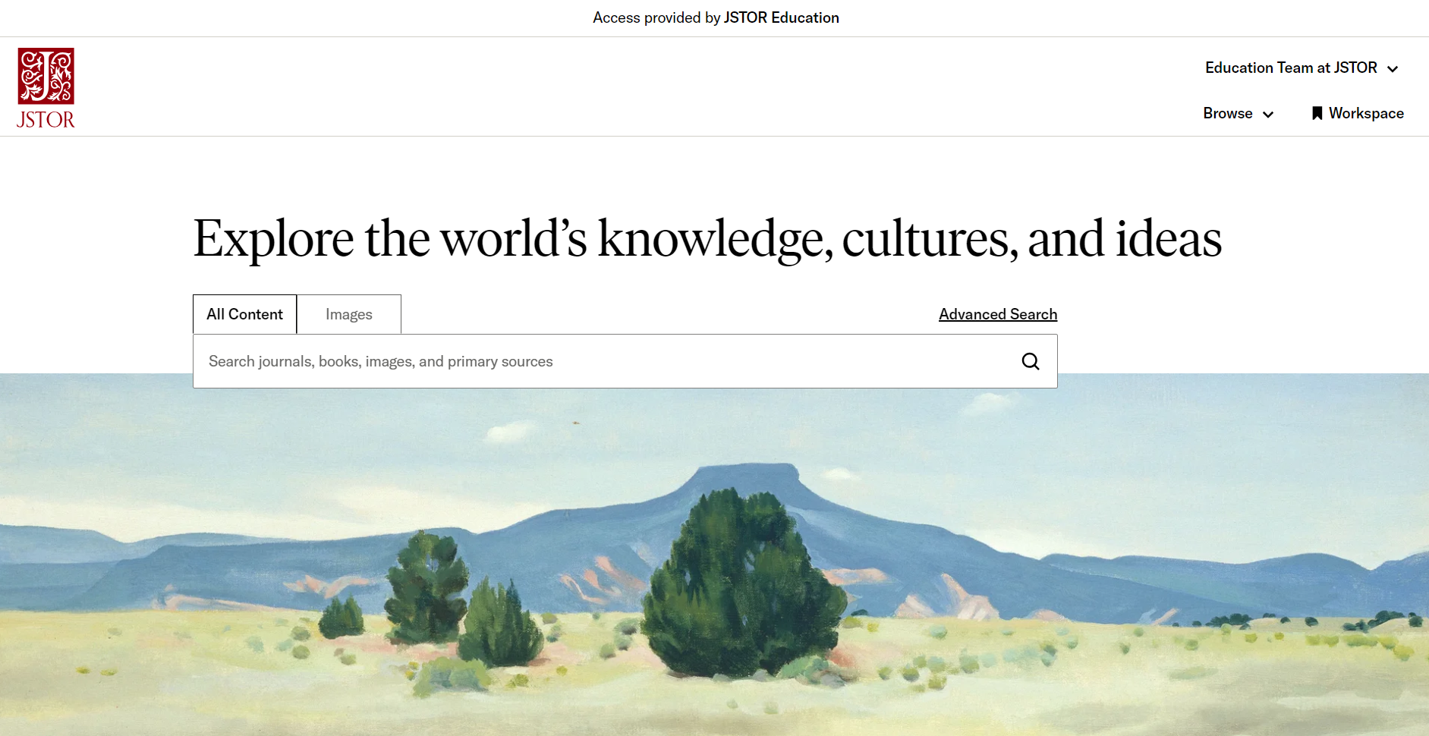
Workspace > logging in
You know you are logged in with your personal account when you see:
1
Name of your school or institution here
Your name here
2
Notes:
Key Point: You will know your logged in when you see the name of your school or institution at the top of the page, and your own name below that.
More information: How to tell if you’re logged in to JSTOR
JSTOR training video on creating a personal account: How to create a JSTOR account - for anyone!

Slide 23
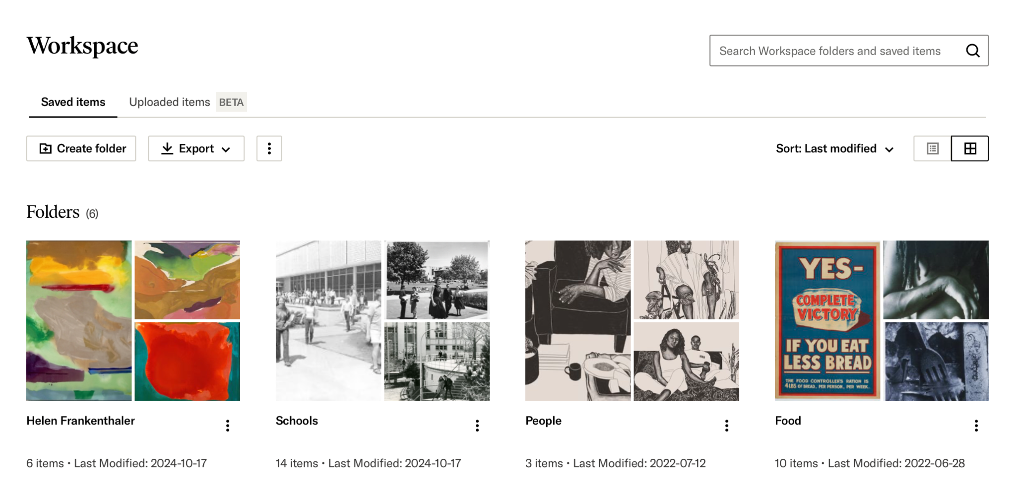
Workspace > saving
Save to your JSTOR Workspace to be able to:
Keep what you find
on JSTOR
Download folders
of items
Share folders
Present what you find
Notes:
Key Points:
The personal account allows you access to their Workspace where you can
save items to your Workspace
download more than one item at a time
share folders of content with others
More information: Introduction to Workspace – JSTOR Support
Finding and saving images on JSTOR - Artstor on JSTOR: Working with images - LibGuides at JSTOR

Slide 24
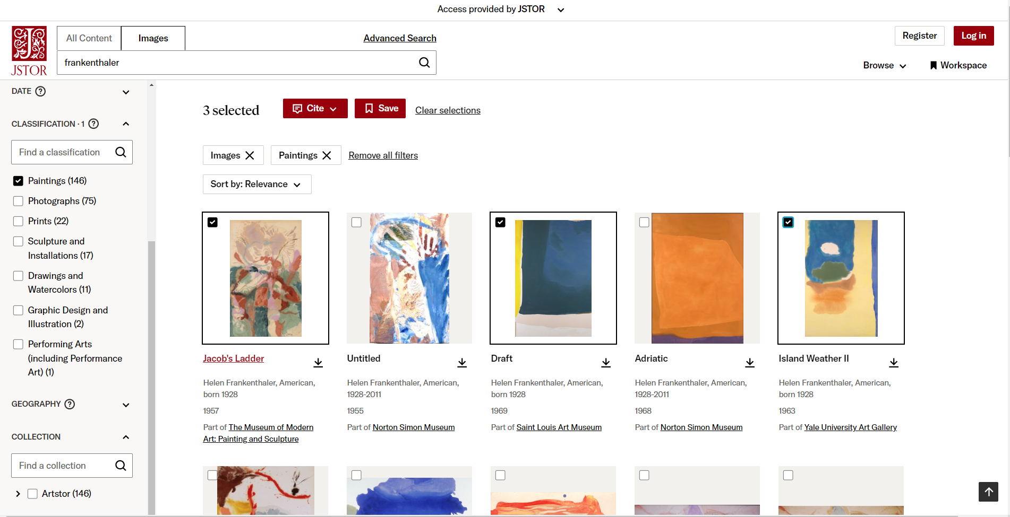
Workspace > saving
1
hover over an item to reveal the check box button
1
2
2
click on the save button at the top of the page
Notes:
Key Points:
Hovering over the image thumbnail is a quick way to save an image to your workspace.
You can save one or several images from your search result.
More information: Images on JSTOR: Getting Started
Finding and saving images on JSTOR - Artstor on JSTOR: Working with images - LibGuides at JSTOR

Slide 25
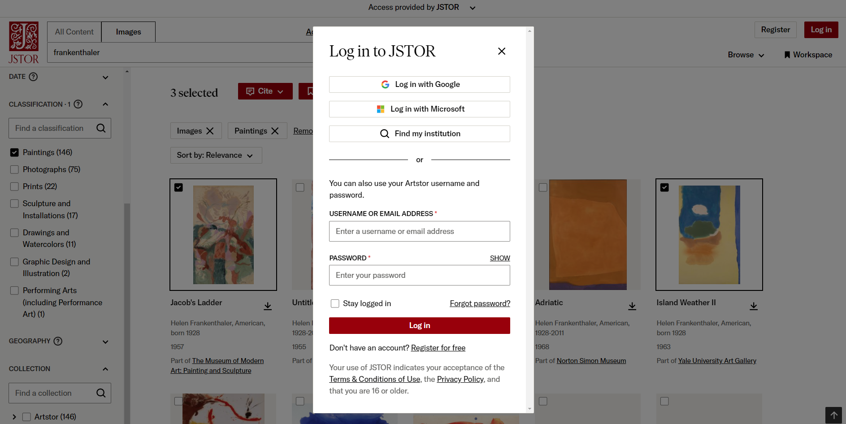
Workspace > saving
A pop up box will appear when you try to save if you are not already logged in.
Notes:
Key Points: There are several ways to log in or register for an account. Check with your library to learn if you have Google or Microsoft single sign on to automatically pair your account to your institution.
More information: Images on JSTOR: Getting Started
Need Help Logging in to JSTOR?
Finding and saving images on JSTOR - Artstor on JSTOR: Working with images - LibGuides at JSTOR

Slide 26
Workspace > saving from the item page
click on the Save button on the item page
Notes:
Key Point: You can also save from the image item page.
More information: Images on JSTOR: Getting Started
Finding and saving images on JSTOR - Artstor on JSTOR: Working with images - LibGuides at JSTOR

Slide 27
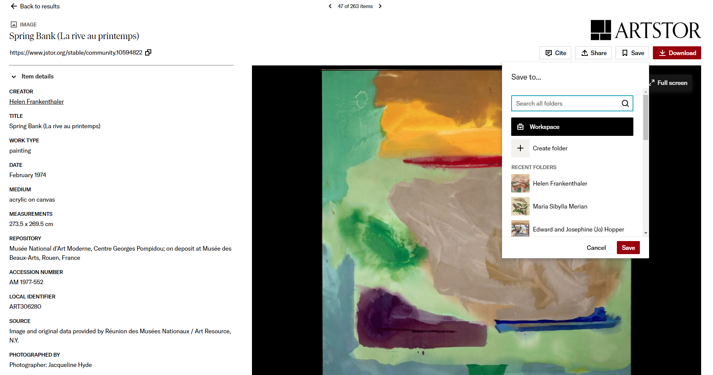
Workspace > saving
Create or save to an existing folder in your Workspace
Notes:
Key point: When you save an item, create a folder to easily organize your content.
Suggested student activity:
On JSTOR, execute an image search from the search bar on any page
If you have not yet created a personal account, click on Register
If you have a personal account, log in
Choose several images from the results page and save them to a folder
Open an image from the search results page and save that individual image to the same folder
More information: Images on JSTOR: Getting Started
Finding and saving images on JSTOR - Artstor on JSTOR: Working with images - LibGuides at JSTOR
Learning outcome aligns with ACRL Framework for Visual Literacy

Slide 28
Organizing, exporting and sharing your Workspace
Notes:
Once you have items in your personal Workspace, you can begin to organize them.

Slide 29
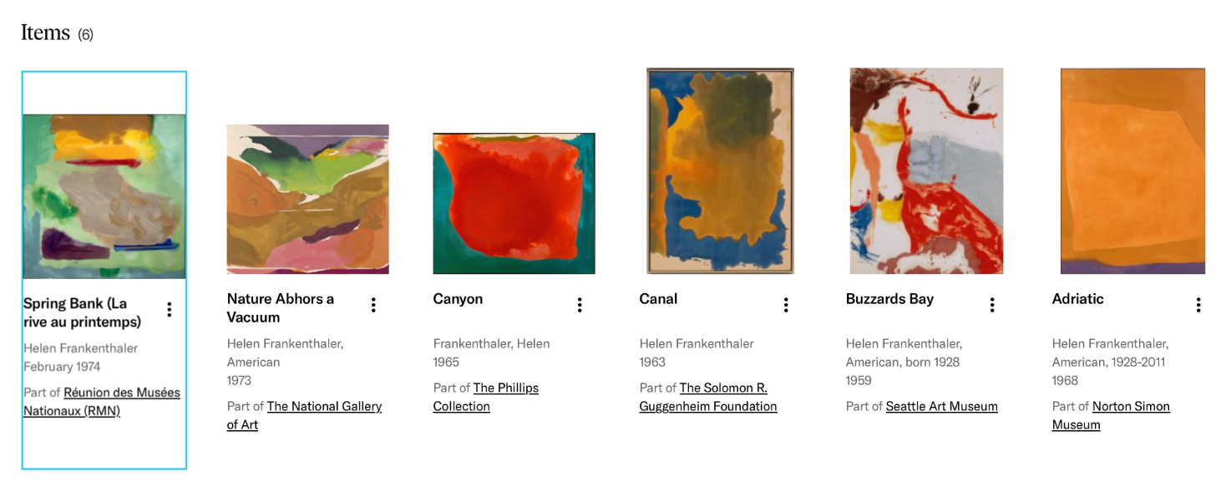
Workspace > organizing
In your Workspace folder, reorder your images by dragging them to the desired location
Notes:
Key Point: once you open a folder you can rearrange the items.
More information: Workspace: Viewing and Organizing your Research – JSTOR Support
Organizing content in your Workspace - Artstor on JSTOR: Working with images

Slide 30
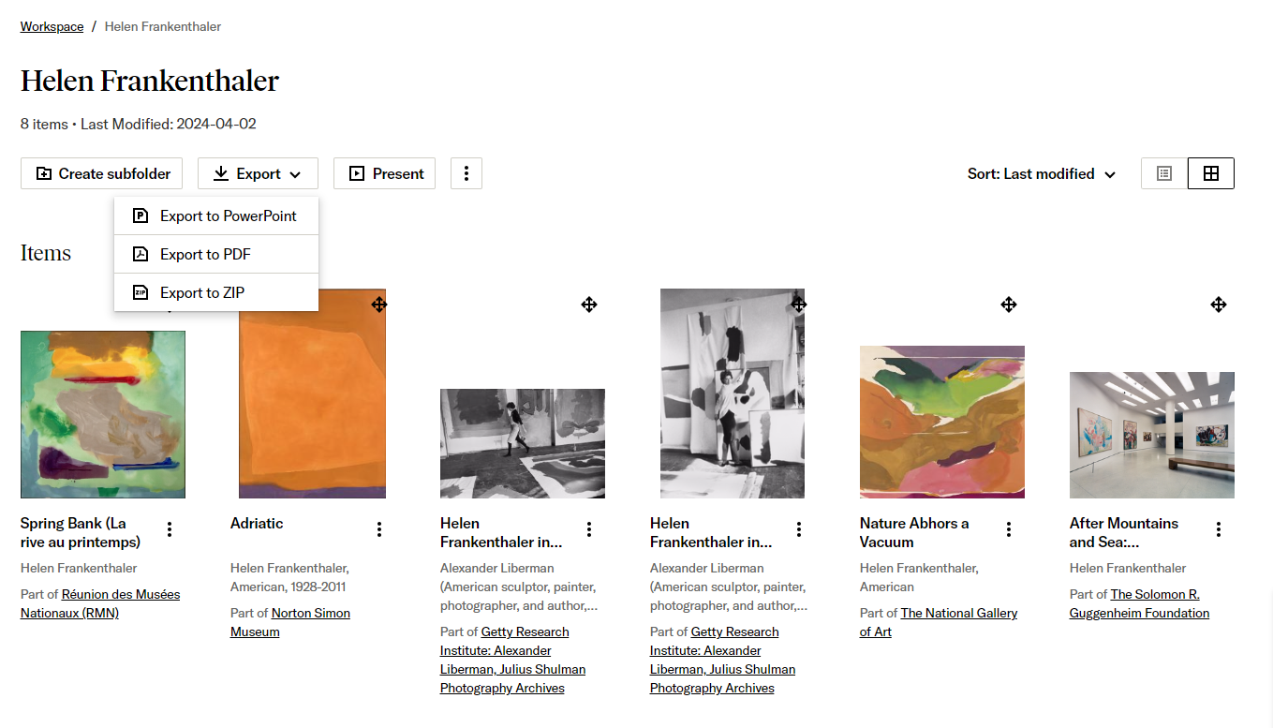
Workspace > organizing
Create subfolders, export or present the content you have discovered
Notes:
Key Point: there are three ways to export (download) the contents of your folder.
Suggested student activities:
Navigate to your Workspace from any page on JSTOR
Open the Workspace folder you created in the last activity.
In your Workspace folder, drag and drop your images to put then in an order you prefer.
Click on the Export button and choose an export format.
More information: Workspace: Viewing and Organizing your Research – JSTOR Support
Organizing content in your Workspace - Artstor on JSTOR: Working with images
Learning outcome aligns with ACRL Visual Literacy Standard 2

Slide 31
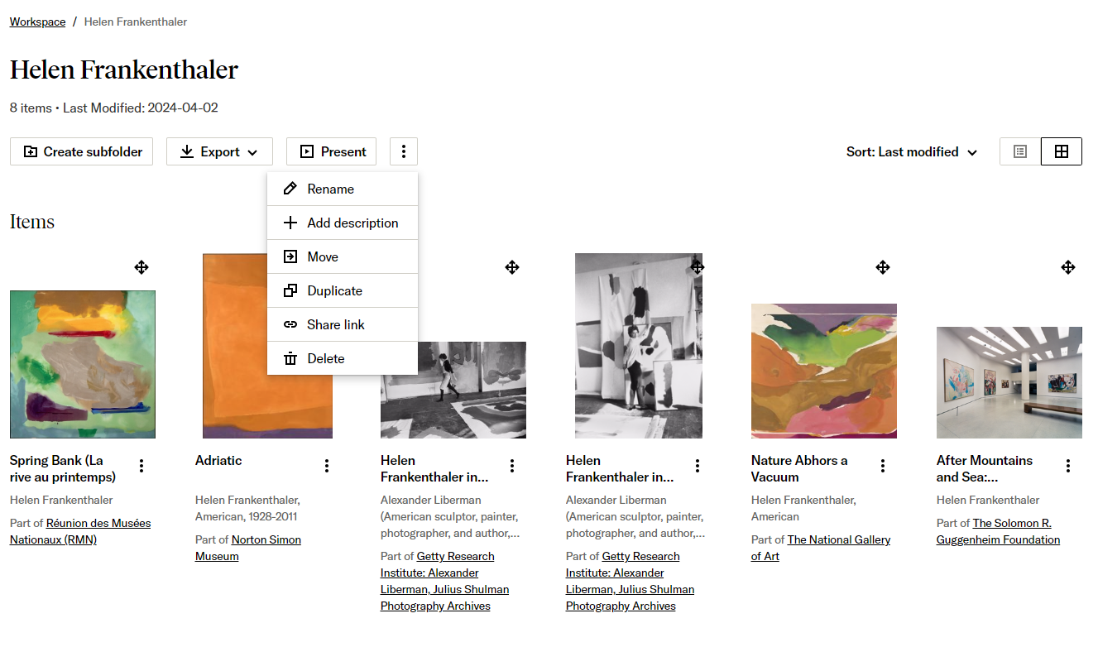
Workspace > organizing and sharing
Click on the three vertical dots for more organizing options, and to share a link
Notes:
Key Point: you can rename a folder, add a description of the folder, duplicate it, share it our delete it.
More information: Workspace: Viewing and Organizing your Research – JSTOR Support
Organizing content in your Workspace - Artstor on JSTOR: Working with images
Sharing content from your Workspace - Artstor on JSTOR: Working with images

Slide 32
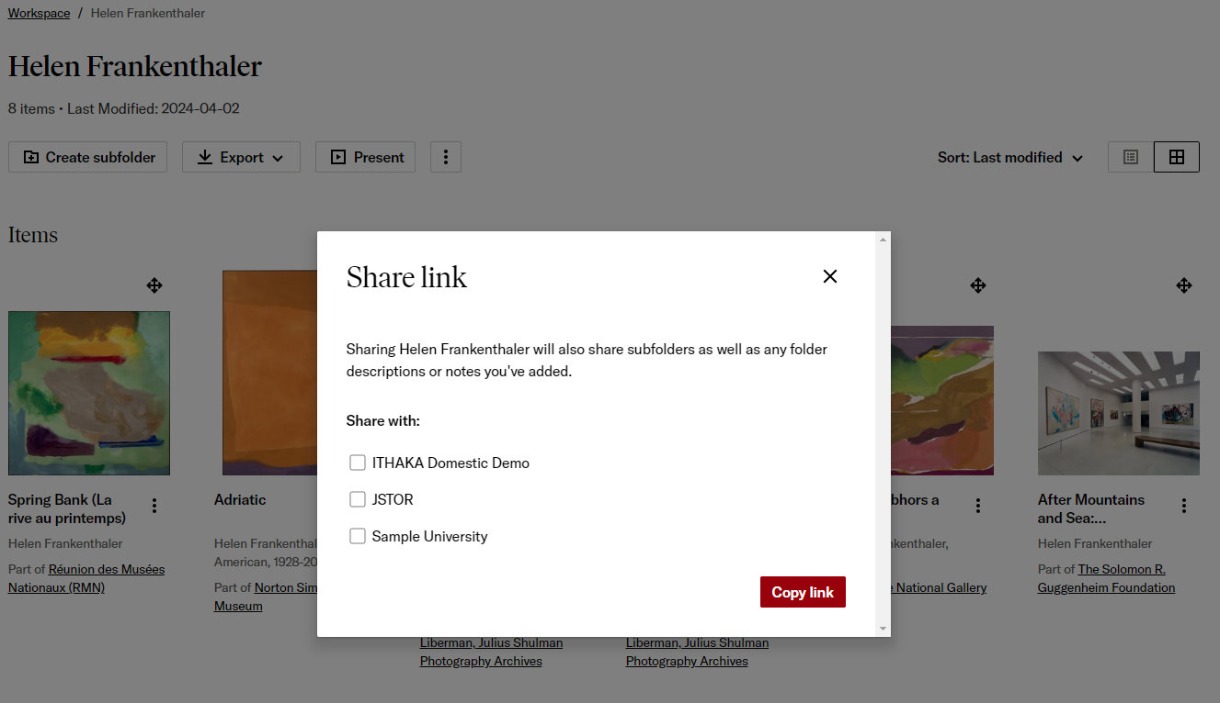
Workspace > sharing
Share with your institution and choose copy link
Notes:
Key Points:
sharing can only be with those at your institution who are logged in
sharing can be turned on or off for each folder
subfolders of a folder are shared along with the parent folder
those with access to your folder can download the content but not change the folder
Suggested student activities:
choose one of your folders and then choose share
copy the link and share it with someone else at your institution or school
More information:Workspace: Sharing Folders – JSTOR Support
Sharing content from your Workspace - Artstor on JSTOR: Working with images
Learning outcome aligns with ACRL Visual Literacy Standard 2

Slide 33
Citing

Slide 34
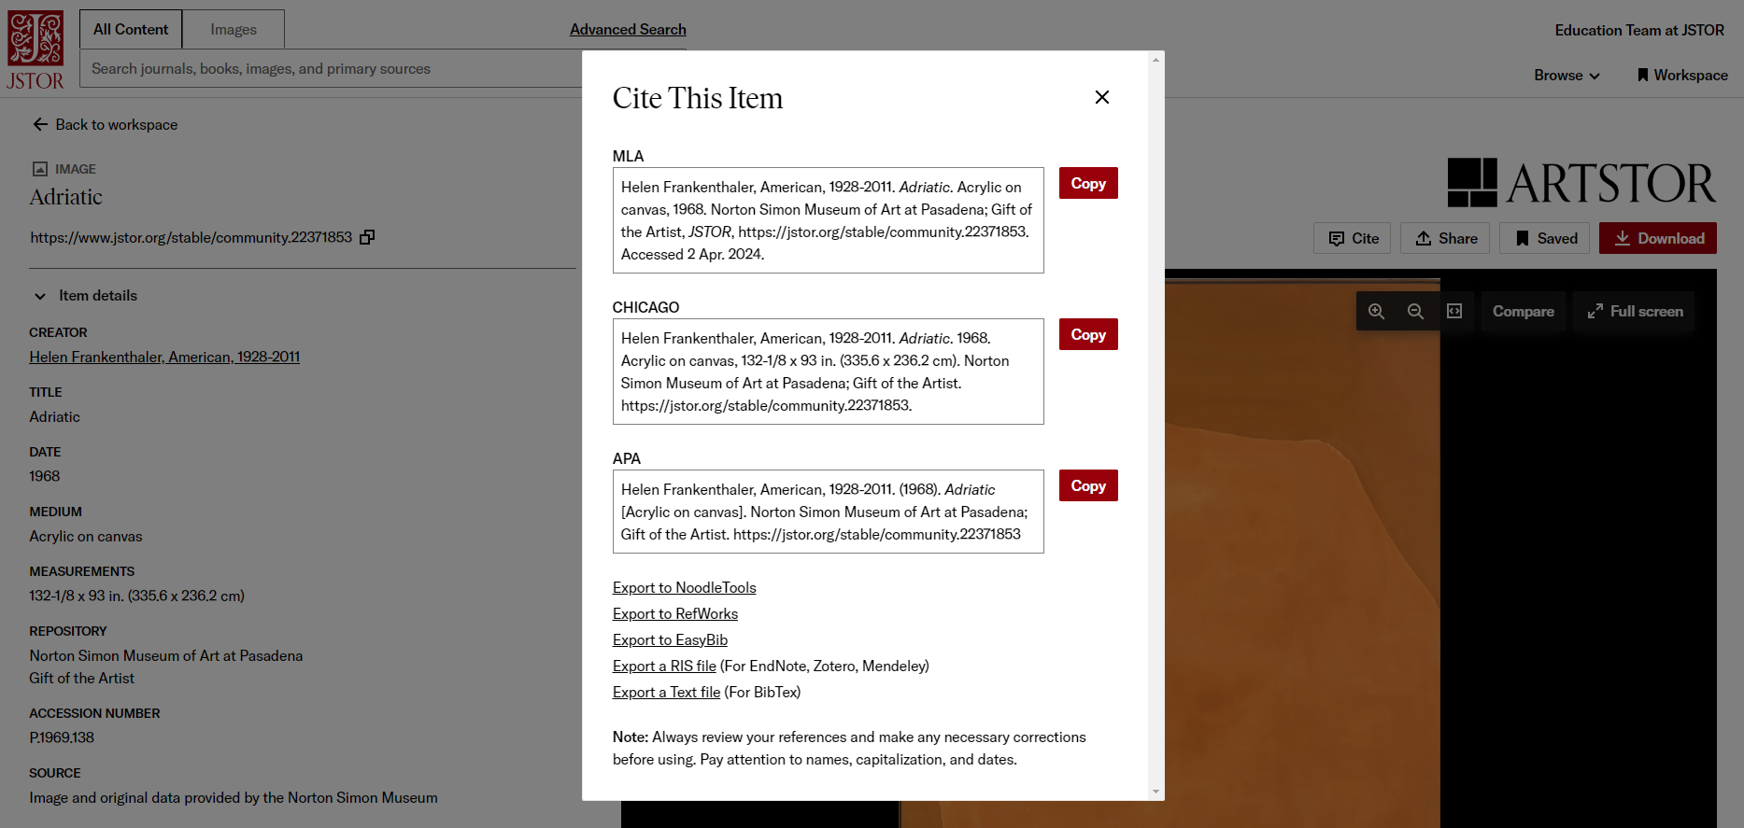
Citing> individual citations
Click on the cite button next to the save button
Notes:
Key Points:
You can copy text for your citations directly or use on of the export tools listed
Always review the text of the citation and edit as needed.
Suggested student activities:
Choose to copy a citation from:
an image from the image thumbnail
a different image from the full image viewer
your Workspace
Review and edit your chosen citations as needed.
More information: Citation Management: Exporting Citations from JSTOR
Learning outcome aligns with ACRL Framework for Visual Literacy

Slide 35
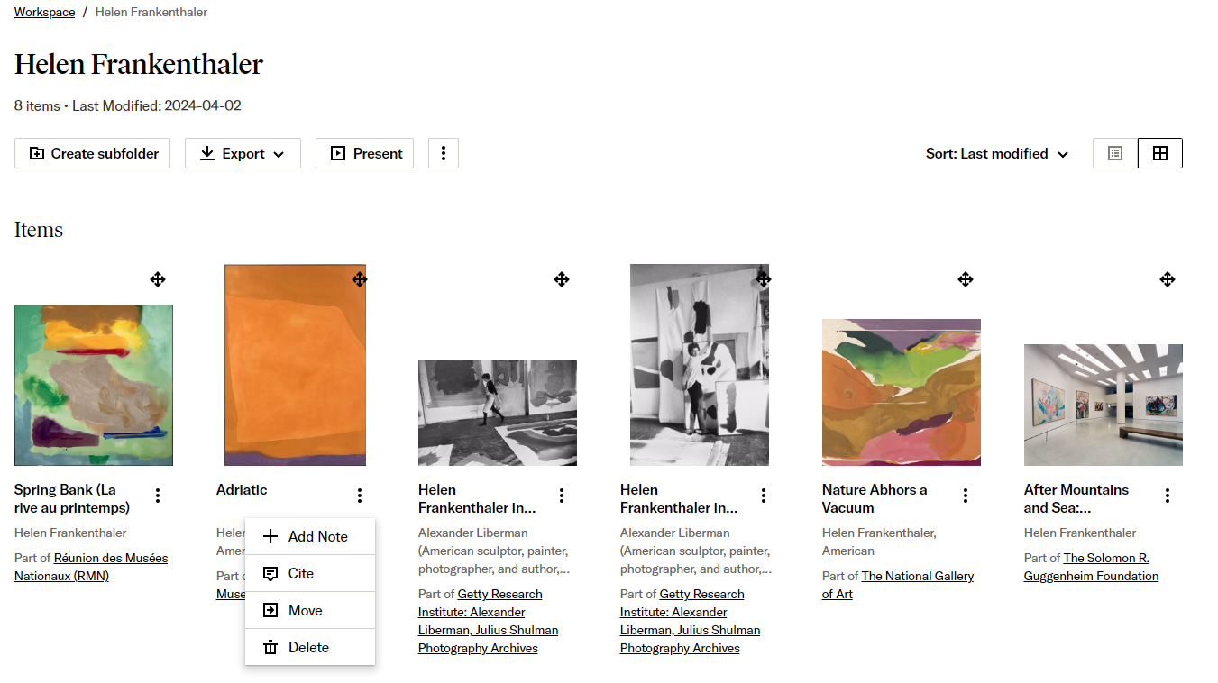
Citing > within Workspace
Copy the citation of an item from the Workspace when you click on the three vertical dots beneath the item thumbnail.
Notes:
Key Points: Just like on the search results page, you can copy citations directly from the item in your Workspace when you click on the dropdown menu beneath the time thumbnail
The supported formats are
MLA 9
APA 7
Chicago 17
Always review the text of the citation and edit as needed
More information: Citation Management: Exporting Citations from JSTOR
Learning outcome aligns with ACRL Framework for Visual Literacy

Slide 36

Happy searching!
Contact support@jstor.org with any questions

